Slide 1
Introduction to
Convolutional Neural Networks
Mrinaal Dogra

Slide 2
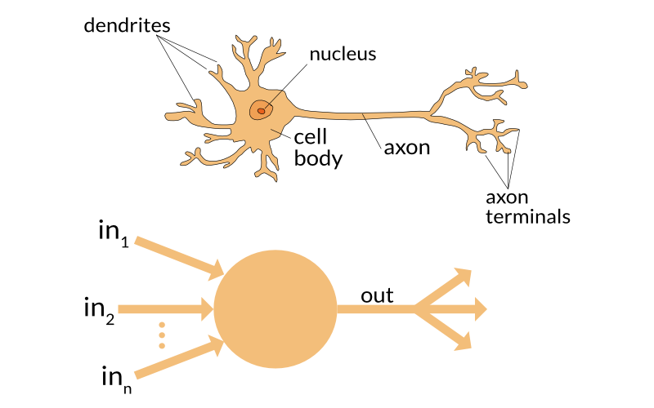
Revisiting Neural Networks
Notes:
Image source : https://s3-ap-south-1.amazonaws.com/av-blog-media/wp-content/uploads/2017/05/20113236/neuron.png

Slide 3
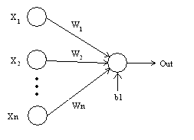
Weights : When input enters the neuron, it is multiplied by a weight. The neural network after training assigns a higher weight to the input it considers more important as compared to the ones which are considered less important.
Bias : In addition to the weights, another linear component is applied to the input, called as the bias. The bias is basically added to change the range of the weight multiplied input.
Revisiting Neural Networks
Notes:
Image source : https://s3-ap-south-1.amazonaws.com/av-blog-media/wp-content/uploads/2017/05/21145421/Perceptron.bmp

Slide 4
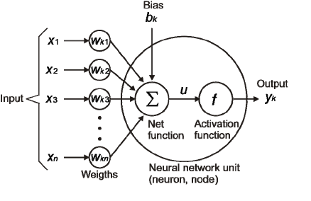
Activation Function : Once the linear component is applied to the input, a nonlinear function is applied to it. The activation function translates the input signals to output signals.
Revisiting Neural Networks
Notes:
Image source : https://s3-ap-south-1.amazonaws.com/av-blog-media/wp-content/uploads/2017/05/20090158/node-output.png

Slide 5
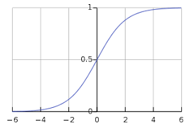
Commonly Applied Activation Functions :
Sigmoid Function :
sigmoid(x) = 1/(1+e^{-x})
2. Softmax Function : It is similar to the sigmoid function, with the only difference being that the outputs are normalized to sum up to 1.
Revisiting Neural Networks
Notes:
Image source : https://s3-ap-south-1.amazonaws.com/av-blog-media/wp-content/uploads/2017/05/20074019/sinmoid.png

Slide 6
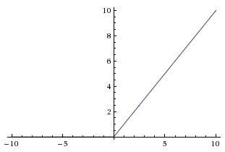
3. ReLU(Rectified Linear Units) :
f(x) = max(0,x)
Revisiting Neural Networks
Notes:
Image source : https://s3-ap-south-1.amazonaws.com/av-blog-media/wp-content/uploads/2017/05/20074000/relu.png

Slide 7
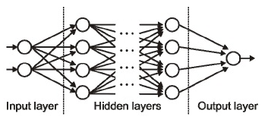
Input / Output / Hidden Layer :
The input layer is the one which receives the input.
The output layer is the one which generates the output.
The processing layers are the hidden layers within the network.
Revisiting Neural Networks
Notes:
Image source :

Slide 8
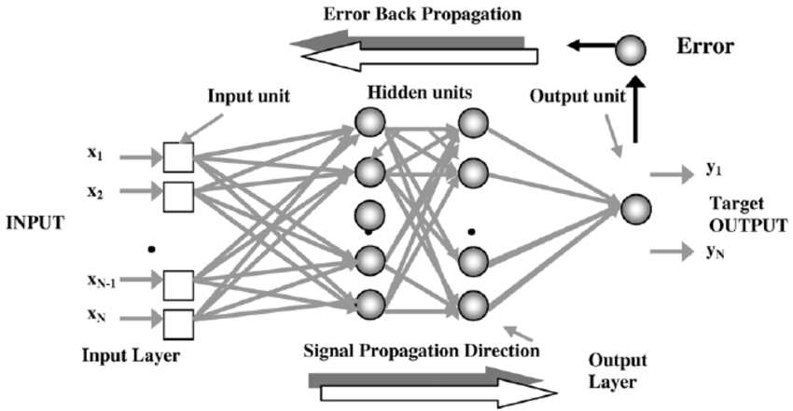
Backpropagation : Once we have received the output for a single iteration, we can calculate the error of the network. This error is then fed back to the network along with the gradient of the cost function to update the weights of the network. These weights are then updated so that the errors in the subsequent iterations is reduced. This updating of weights using the gradient of the cost function is known as back-propagation.
In back-propagation the movement of the network is backwards, the error along with the gradient flows back from the output layer through the hidden layers and the weights are updated.
Revisiting Neural Networks
Notes:
Image source : http://backlinksforseo.com/wp-content/uploads/2016/12/backprop.png

Slide 9
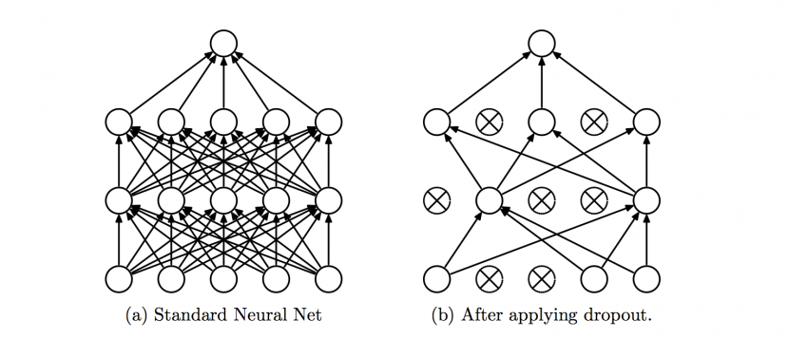
Dropout :
A regularization technique which prevents over-fitting of the network.
During training a certain number of neurons in the hidden layer is randomly dropped.
You can think of drop out as an ensemble technique, where the output of multiple networks is then used to produce the final output.
Revisiting Neural Networks
Notes:
Image source : https://s3-ap-south-1.amazonaws.com/av-blog-media/wp-content/uploads/2017/05/20073927/dropout-850x357.png
Original Paper : https://arxiv.org/pdf/1207.0580.pdf

Slide 10
Batches :
While training a neural network, instead of sending the entire input in one go, we divide the input into several chunks of equal size randomly.
Training the data on batches makes the model more generalized as compared to the model built when the entire data set is fed to the network in one go.
Epochs :
Defined as a single training iteration of all batches in both forward and back propagation.
More number of epochs would show higher accuracy of the network, however, it would also take longer for the network to converge.
Also you must take care that if the number of epochs are too high, the network might over-fit.
Total number of inputs | = Number of steps per epoch
Batch size
Revisiting Neural Networks

Slide 11
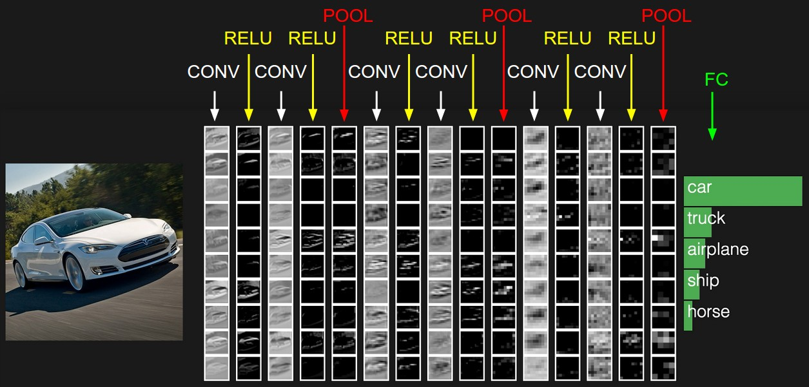
Convolutional Neural Networks

Slide 12
Convolutional Neural Networks are very similar to ordinary Neural Networks :
They are made up of neurons that have learnable weights and biases.
Each neuron receives some inputs, performs a dot product and optionally follows it with a non-linearity.
The whole network still expresses a single differentiable score function: from the raw image pixels on one end to class scores at the other.
They still have a loss function (e.g. SVM/Softmax) on the last (fully-connected) layer.
Convolutional Neural Networks

Slide 13
So what does change?
ConvNet architectures make the explicit assumption that the inputs are images, which allows us to encode certain properties into the architecture.
These then make the forward function more efficient to implement and vastly reduce the amount of parameters in the network.
Convolutional Neural Networks

Slide 14
Why such a difference?
Regular Neural Networks don’t scale well to full images.
Image Size | Number of weights in the first hidden layer
32 x 32 x 3 | 32 * 32 * 3 = 3,072
200 x 200 x 3 (a more respectable size) | 200 * 200 * 3 = 120,000
Convolutional Neural Networks

Slide 15
Architecture Overview
3D volumes of neurons :
Convolutional Neural Networks take advantage of the fact that the input consists of images.
Unlike a regular Neural Network, the layers of a ConvNet have neurons arranged in 3 dimensions: width, height, depth. (Note that the word depth here refers to the third dimension of an activation volume, not the depth of a full Neural Network, which can refer to the total number of layers in a network.)
Convolutional Neural Networks : Architecture Overview

Slide 16
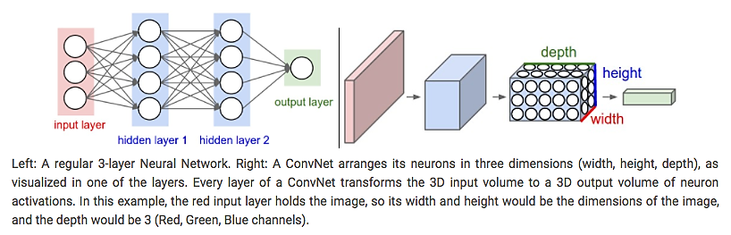
Convolutional Neural Networks : Architecture Overview
Notes:
Image source : http://cs231n.github.io/convolutional-networks/

Slide 17
Properties of Layers
Local Connectivity :
When dealing with high-dimensional inputs such as images, it is impractical to connect neurons to all neurons in the previous volume.
Instead, we will connect each neuron to only a local region of the input volume.
The spatial extent of this connectivity is a hyper parameter called the receptive field of the neuron (equivalently this is the filter size).
The extent of the connectivity along the depth axis is always equal to the depth of the input volume.
The connections are local in space (along width and height), but always full along the entire depth of the input volume.
Convolutional Neural Networks : Properties of Layers

Slide 18
Spatial Arrangement
Three hyper parameters control the size of the output volume :
Depth of the output volume :
It corresponds to the number of filters we would like to use, each learning to look for something different in the input. For example, if the first Convolutional Layer takes as input the raw image, then different neurons along the depth dimension may activate in presence of various oriented edges, or blobs of color. We will refer to a.
Set of neurons that are all looking at the same region of the input are referred as a depth column (some people also prefer the term fibre).
Convolutional Neural Networks : Properties of Layers – Spatial Arrangement

Slide 19
2. Zero-Padding :
Sometimes it will be convenient to pad the input volume with zeros around the border.
It will allow us to control the spatial size of the output volumes.
Reasons :
To keep the spatial size constant
There is a chance that the borders may wash off if no padding is used
3. Stride :
Number of pixels moved while sliding the filter.
When the stride is 1 then we move the filters one pixel at a time. When the stride is 2 (or uncommonly 3 or more, though this is rare in practice) then the filters jump 2 pixels at a time as we slide them around.
This will produce smaller output volumes spatially.
Convolutional Neural Networks : Properties of Layers – Spatial Arrangement

Slide 20
Calculation of Output Volume
We can compute the spatial size of the output volume as a function of :
- The input volume size (W)
- The receptive field size of the CONV Layer neurons (F)
- The stride with which they are applied (S)
- The amount of zero padding used (P) on the border.
The correct formula for calculating how many neurons “fit” is given by :
1 + | (W – F + 2P)
 | S
Convolutional Neural Networks : Properties of Layers

Slide 21
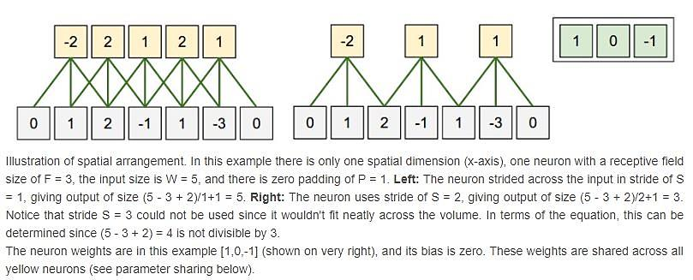
Convolutional Neural Networks : Properties of Layers

Slide 22
Parameter Sharing :
Parameter sharing scheme is used in Convolutional Layers to control the number of parameters.
Suppose we have an input image of size [ 227 x 227 x 3 ] and on the first Convolutional Layer, it used neurons with receptive field size F=11, stride S=4, depth K=96, and no zero padding P=0. Since ( (227 - 11)/4 ) + 1 = 55, the Conv layer output volume had size [ 55 x 55 x 96 ].
Using the real-world example above, we see that there are 55*55*96 = 290,400 neurons in the first Conv Layer, and each has 11*11*3 = 363 weights and 1 bias. Together, this adds up to 290400 * 364 = 105,705,600 parameters on the first layer of the ConvNet alone. Clearly, this number is very high.
Convolutional Neural Networks : Parameter Sharing

Slide 23
So, we take an assumption :
If one feature is useful to compute at some spatial position (x,y), then it should also be useful to compute at a different position (x2,y2). In other words, denoting a single 2D slice of depth as a depth slice (e.g. a volume of size [ 55x55x96 ] has 96 depth slices, each of size [ 55x55 ]), we are going to constrain the neurons in each depth slice to use the same weights and bias.
With this parameter sharing scheme, the first Conv Layer in our example would now have only 96 unique set of weights (one for each depth slice), for a total of 96*11*11*3 = 34,848 unique weights, or 34,944 parameters (+96 biases). Alternatively, all 55*55 neurons in each depth slice will now be using the same parameters.
In practice during backpropagation, every neuron in the volume will compute the gradient for its weights, but these gradients will be added up across each depth slice and only update a single set of weights per slice.
Convolutional Neural Networks : Parameter Sharing

Slide 24
Filter Size vs Number of Layers
Suppose that you stack three 3x3 CONV layers on top of each other. In this arrangement, each neuron on the first CONV layer has a 3x3 view of the input volume. A neuron on the second CONV layer has a 3x3 view of the first CONV layer, and hence by extension a 5x5 view of the input volume. Similarly, a neuron on the third CONV layer has a 3x3 view of the 2nd CONV layer, and hence a 7x7 view of the input volume.
Suppose that instead of these three layers of 3x3 CONV, we only wanted to use a single CONV layer with 7x7 receptive fields. These neurons would have a receptive field size of the input volume that is identical in spatial extent (7x7).
So what should we use ??
Convolutional Neural Networks : Filter Size vs Number of Layers

Slide 25
It has been found that the single layer with equal spatial extent comes with several disadvantages :
The neurons would be computing a linear function over the input, while the three stacks of CONV layers contain non-linearities that make their features more expressive.
If we suppose that all the volumes have C channels, then it can be seen that the single 7x7 CONV layer would contain C×(7×7×C) = 49C² parameters, while the three 3x3 CONV layers would only contain 3×(C×(3×3×C)) = 27C² parameters. Intuitively, stacking CONV layers with tiny filters as opposed to having one CONV layer with big filters allows us to express more powerful features of the input, and with fewer parameters.
As a practical disadvantage, we might need more memory to hold all the intermediate CONV layer results if we plan to do backpropagation.
Convolutional Neural Networks : Filter Size vs Number of Layers
Notes:
×

Slide 26
Layers used to build ConvNets
We use three main types of layers to build ConvNet architectures:
- Convolutional Layer (CONV)
- Pooling Layer (POOL)
- Fully-Connected Layer (FC)
- Normalization Layer (had lost its popularity in recent years)
ConvNets transform the original image layer by layer from the original pixel values to the final class scores. Note that some layers contain parameters and other don’t. In particular, the CONV/FC layers perform transformations that are a function of not only the activations in the input volume, but also of the parameters (the weights and biases of the neurons). On the other hand, the Normalization/POOL layers will implement a fixed function. The parameters in the CONV/FC layers will be trained with gradient descent so that the class scores that the ConvNet computes are consistent with the labels in the training set for each image.
Convolutional Neural Networks : Layers

Slide 27
Convolutional Layer
The CONV layer’s parameters consist of a set of learnable filters.
During the forward pass, we slide (more precisely, convolve) each filter across the width and height of the input volume and compute dot products between the entries of the filter and the input at any position.
As we slide the filter over the width and height of the input volume we will produce a 2-dimensional activation map that gives the responses of that filter at every spatial position.
Now, we will have an entire set of filters in each CONV layer, and each of them will produce a separate 2-dimensional activation map. We will stack these activation maps along the depth dimension and produce the output volume.
Convolutional Neural Networks : Layers
Notes:
Intuitively, the network will learn filters that activate when they see some type of visual feature such as an edge of some orientation or a blotch of some color on the first layer, or eventually entire honeycomb or wheel-like patterns on higher layers of the network.

Slide 28
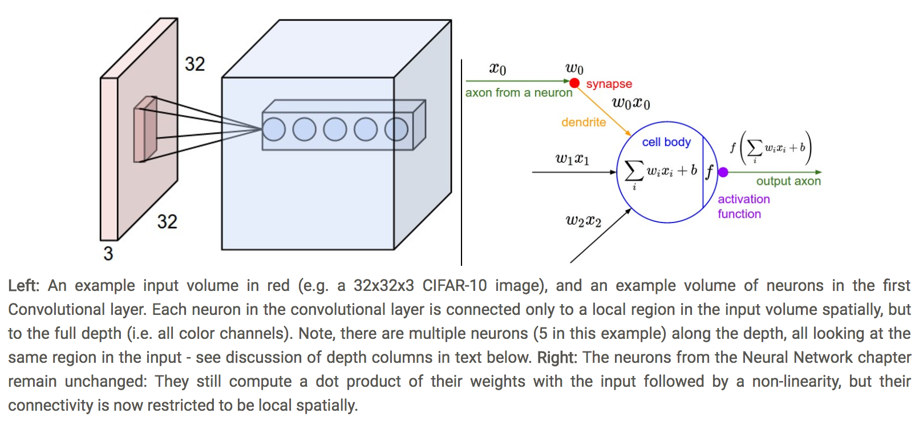
Convolutional Neural Networks : Layers

Slide 29
Summary :
Accepts a volume of size W₁ x H₁ x D₁
Requires four hyperparameters :
Number of filters K,
Their spatial extent F,
The stride S,
The amount of zero padding P
Produces a volume of size W₂ x H₂ x D₂ where :
W₂ = 1 + (W₁ - F + 2P)/S
H₂ = 1 + (H₁ - F + 2P)/S
D₂ = K
With parameter sharing, it introduces F . F . D₁ weights per filter, for a total of (F . F. D₁) . K weights and K biases.
In the output volume, d-th depth slice (of size W₂ x H₂) is the result of performing a valid convolution of d-th filter over the input volume with a stride of S and then offset by d-th bias.
A common setting of hyperparameters is F = 3, S = 1, P = 1.
Convolutional Neural Networks : Layers

Slide 30
Pooling Layer
Its function is to progressively reduce the spatial size of the representation to reduce the amount of parameters and computation in the network, and hence to also control overfitting.
The pooling layer
Accepts a volume of size W₁×H₁×D₁
Requires two hyperparameters:
their spatial extent F,
the stride S,
Produces a volume of size W₂×H₂×D₂ where:
W₂ = 1 + (W₁ − F)/S
H₂ = 1 + (H₁ − F)/S
D₂ = D₁
Introduces zero parameters since it computes a fixed function of the input
Two commonly seen variations of the max pooling layer found in practice:
F = 3, S = 2 (also called overlapping pooling)
more commonly F = 2, S = 2.
Pooling sizes with larger receptive fields are too destructive.
Convolutional Neural Networks : Layers

Slide 31
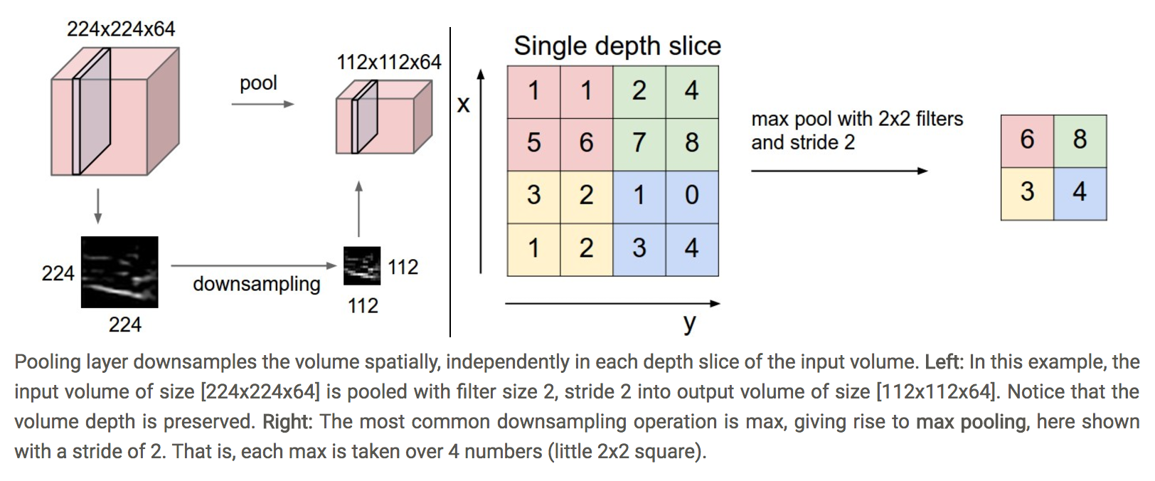
Convolutional Neural Networks : Layers

Slide 32
ConvNet Architecture Patterns
The most common ConvNet architecture follows the pattern
INPUT -> [[CONV -> RELU]*N -> POOL?]*M -> [FC -> RELU]*K -> FC
Moreover, N >= 0 (and usually N <= 3), M >= 0, K >= 0 (and usually K < 3).
Some common ConvNet architecture patterns :
INPUT -> FC, implements a linear classifier. Here N = M = K = 0.
INPUT -> [CONV -> RELU -> POOL]*2 -> FC -> RELU -> FC.
There is a single CONV layer between every POOL layer.
INPUT -> [CONV -> RELU -> CONV -> RELU -> POOL]*3 -> [FC -> RELU]*2 -> FC.
Two CONV layers stacked before every POOL layer. This is generally a good idea for larger and deeper networks, because multiple stacked CONV layers can develop more complex features of the input volume before the destructive pooling operation.
Convolutional Neural Networks : ConvNet Architecture Patterns

Slide 33
For further reading, please visit :
https://www.analyticsvidhya.com/blog/2017/05/25-must-know-terms-concepts-for-beginners-in-deep-learning/
http://cs231n.github.io/convolutional-networks/
Convolutional Neural Networks : ConvNet Architecture Patterns

Slide 34
Thank You
Notes:
Image source : https://snag.gy/vf9AjE.jpg

